Slide 1
Tableau Final project
Yogitha kandhi

Slide 2
I choose Airbnb data for option 2 to do this project.
Connected to the data through Tableau and detected different data types:
The data has 30478 records of property names with 13 attributes
The goal of the project is to do the exploratory data analysis, observe trends patterns and through initial observations to tell a meaningful story through visualization.
The most important features from the data set are
Geographic locations
Property types
Price
Reviews
Date
Questions popped during EDA:
Is there any relationship between joining date of host and number of reviews?
Is there any variation of price based on city?
Cities with higher number of Airbnb’s?
Is there any relationship between price, property type and time?
What’s the forecast for 2015 and 2016?
Most profitable quarter for Airbnb?
Highest reviewed host, highest earning host and host with highest records?

Slide 3
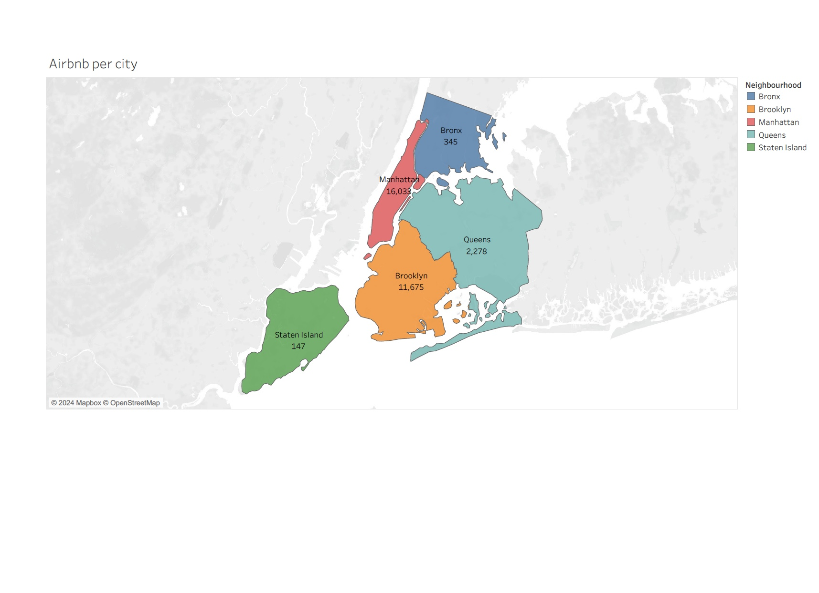
Based in the county we can infer that Manhattan has the highest number of Airbnb

Slide 4
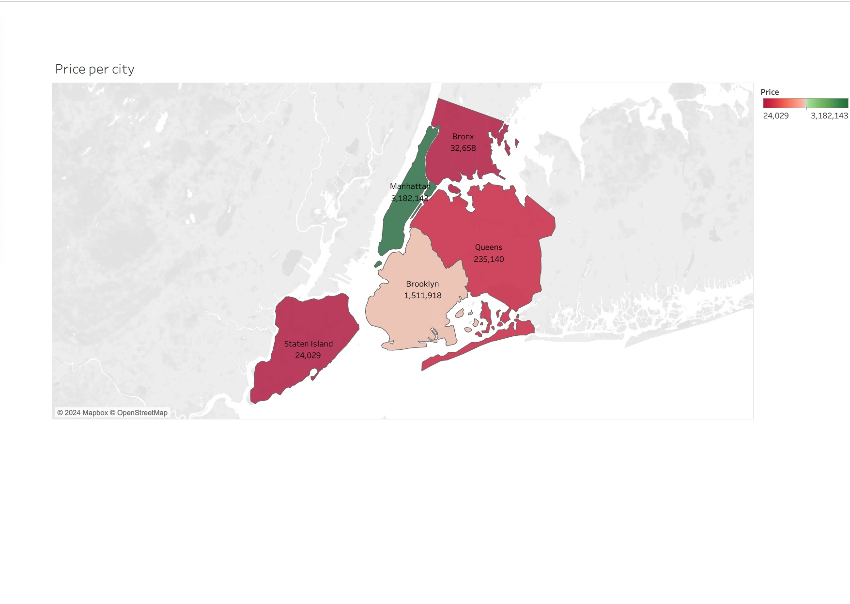
Airbnb is making its maximum revenue from Manhattan.

Slide 5
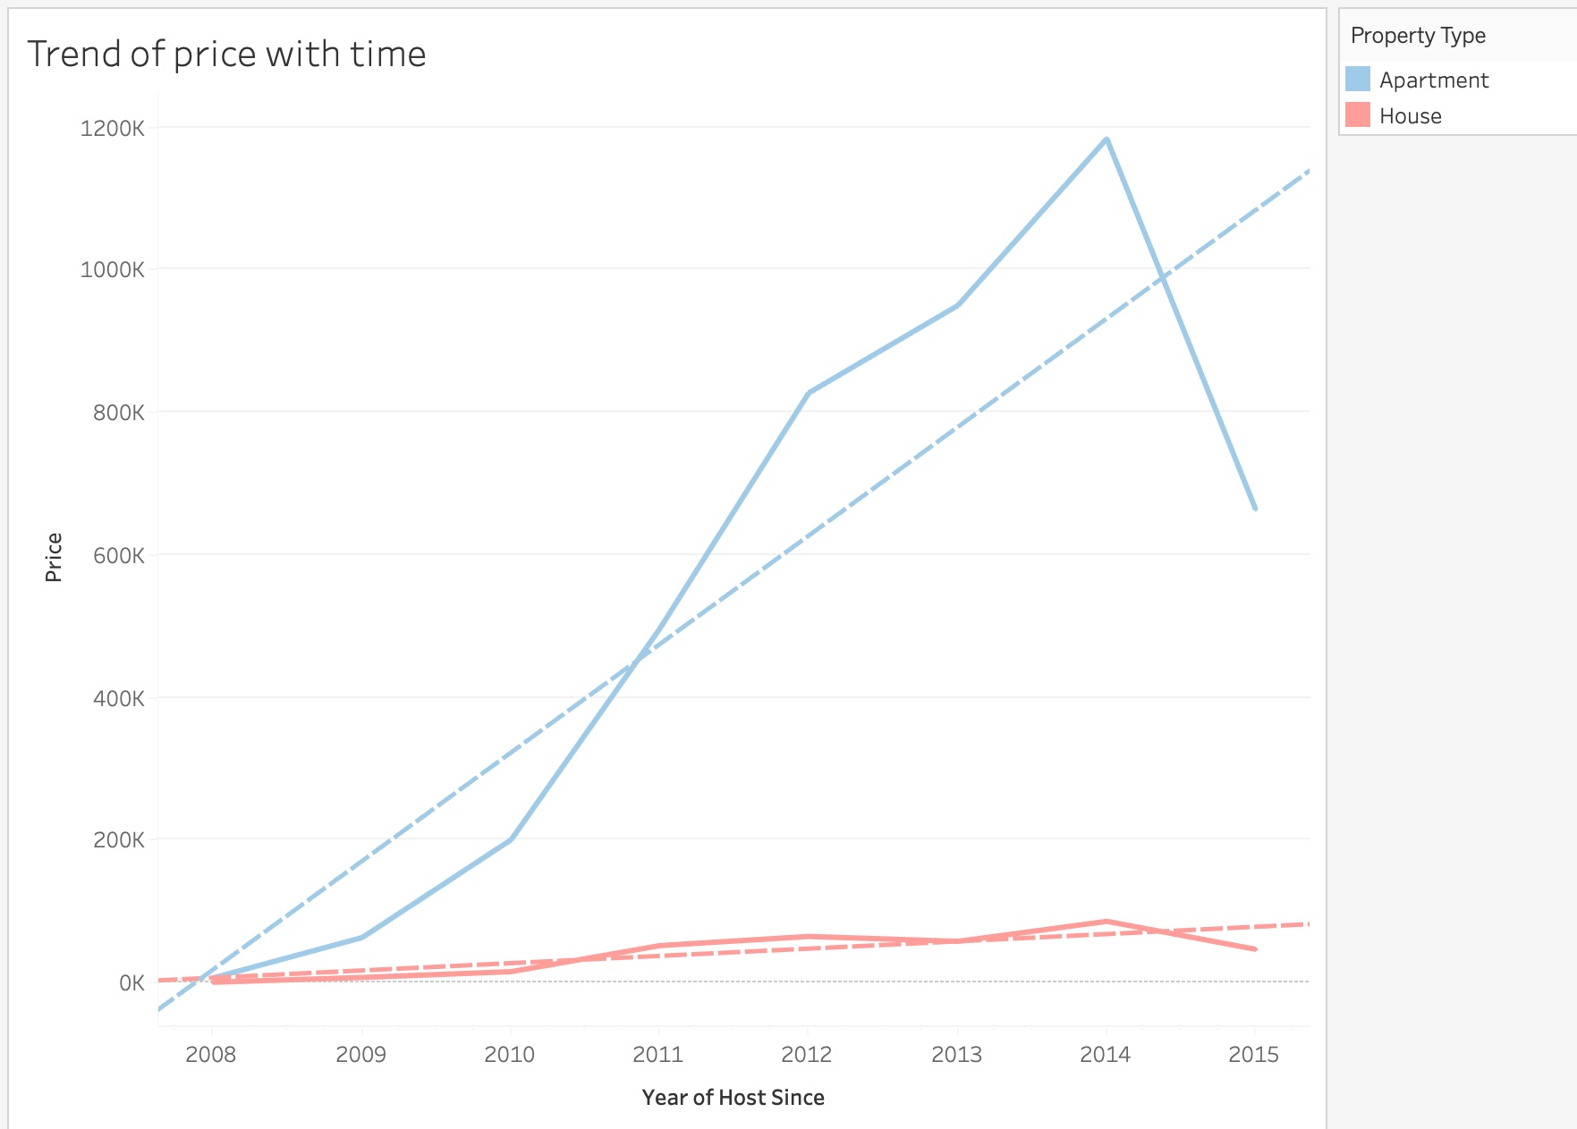
Trend in price of apartment and house with time
The p value is very low making it statistically significant
The apartment prices grew very much faster when compared to the house.

Slide 6
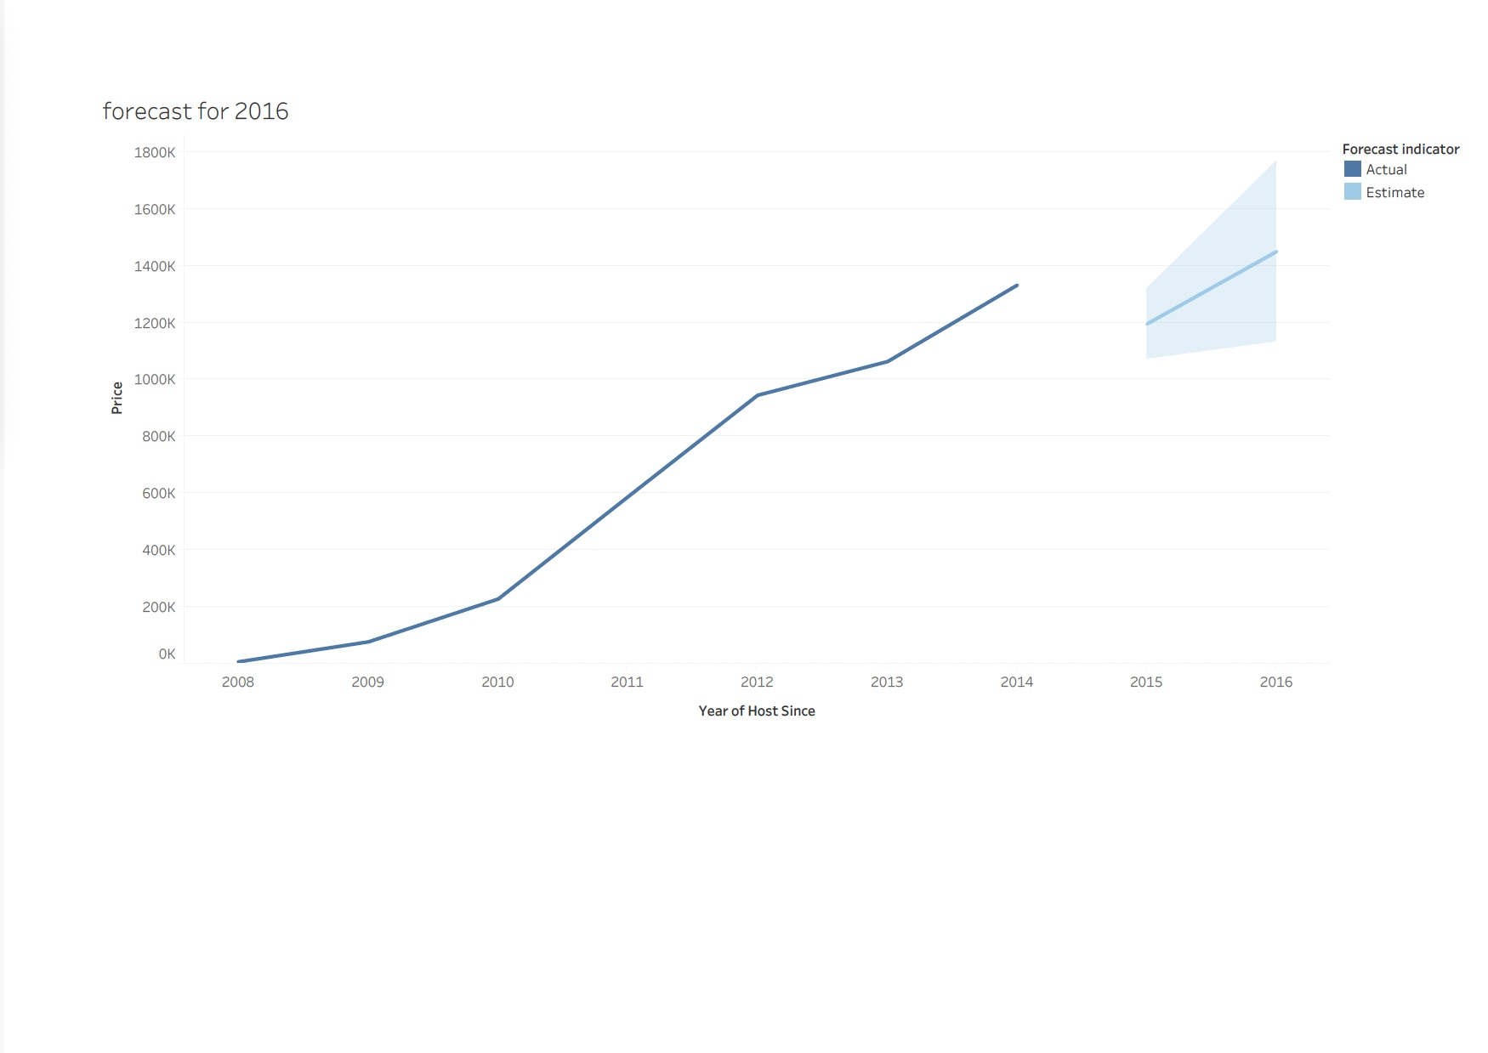
Price Forecast for 2015 – 2016 based on the previous data.

Slide 7
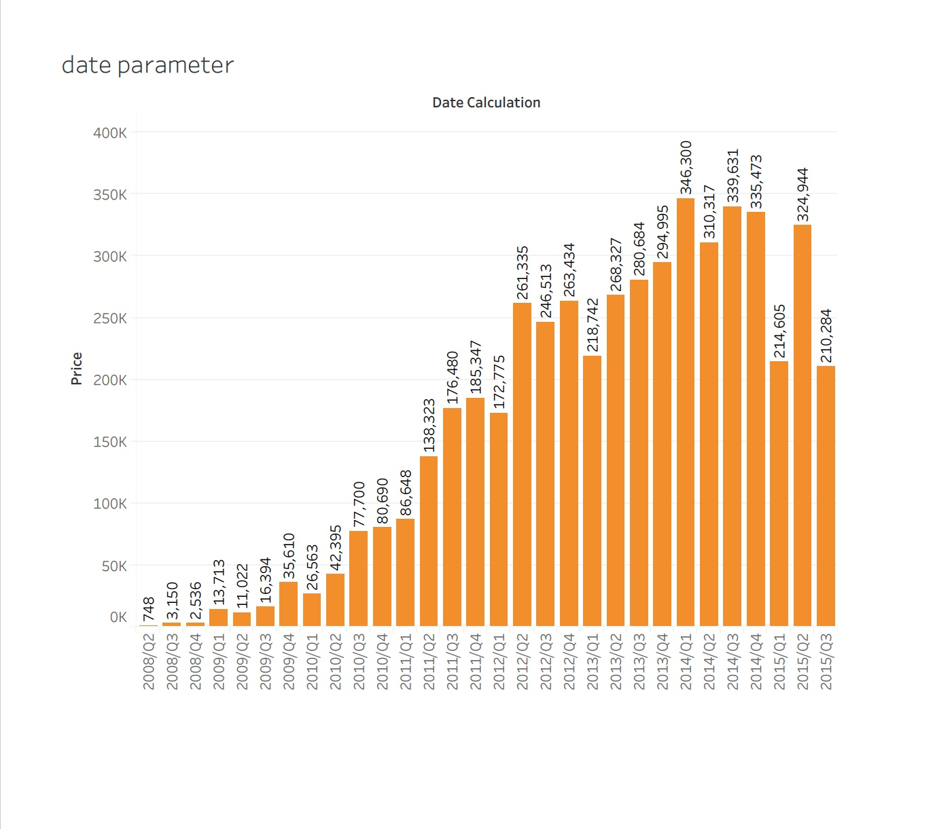
Created a date parameter to identify the most profitable quarter for Airbnb

Slide 8
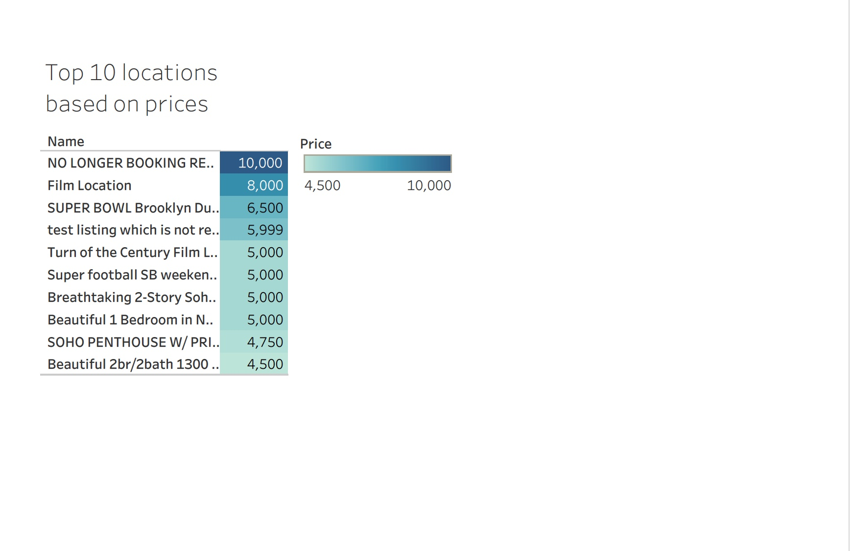
Highly priced Airbnb in the table view

Slide 9
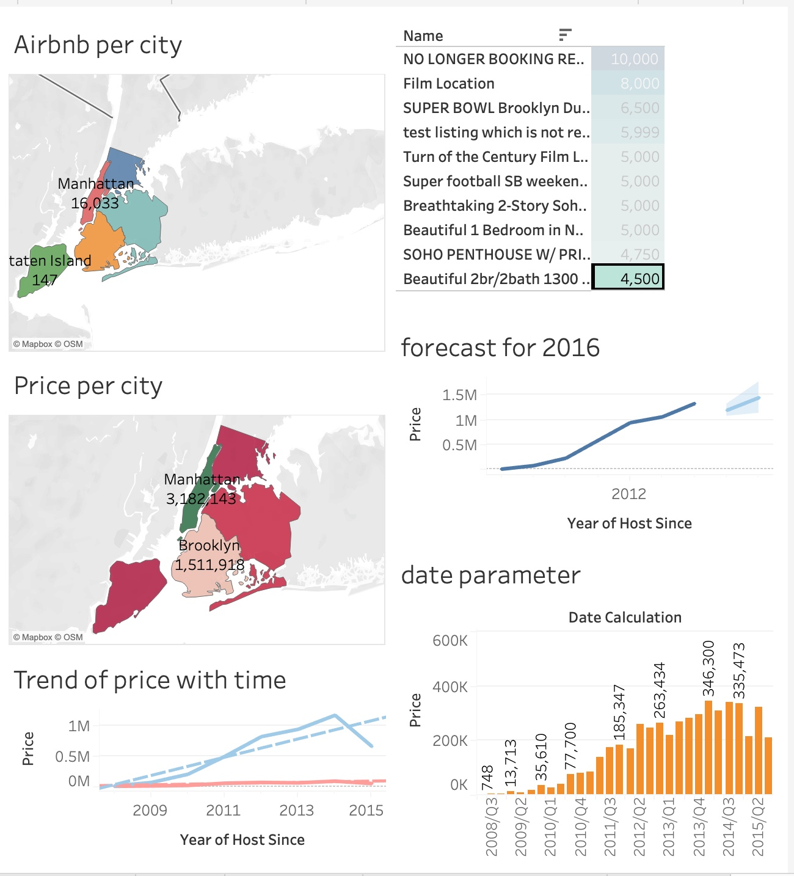
Interactive dashboard with trend and forecast

Slide 10
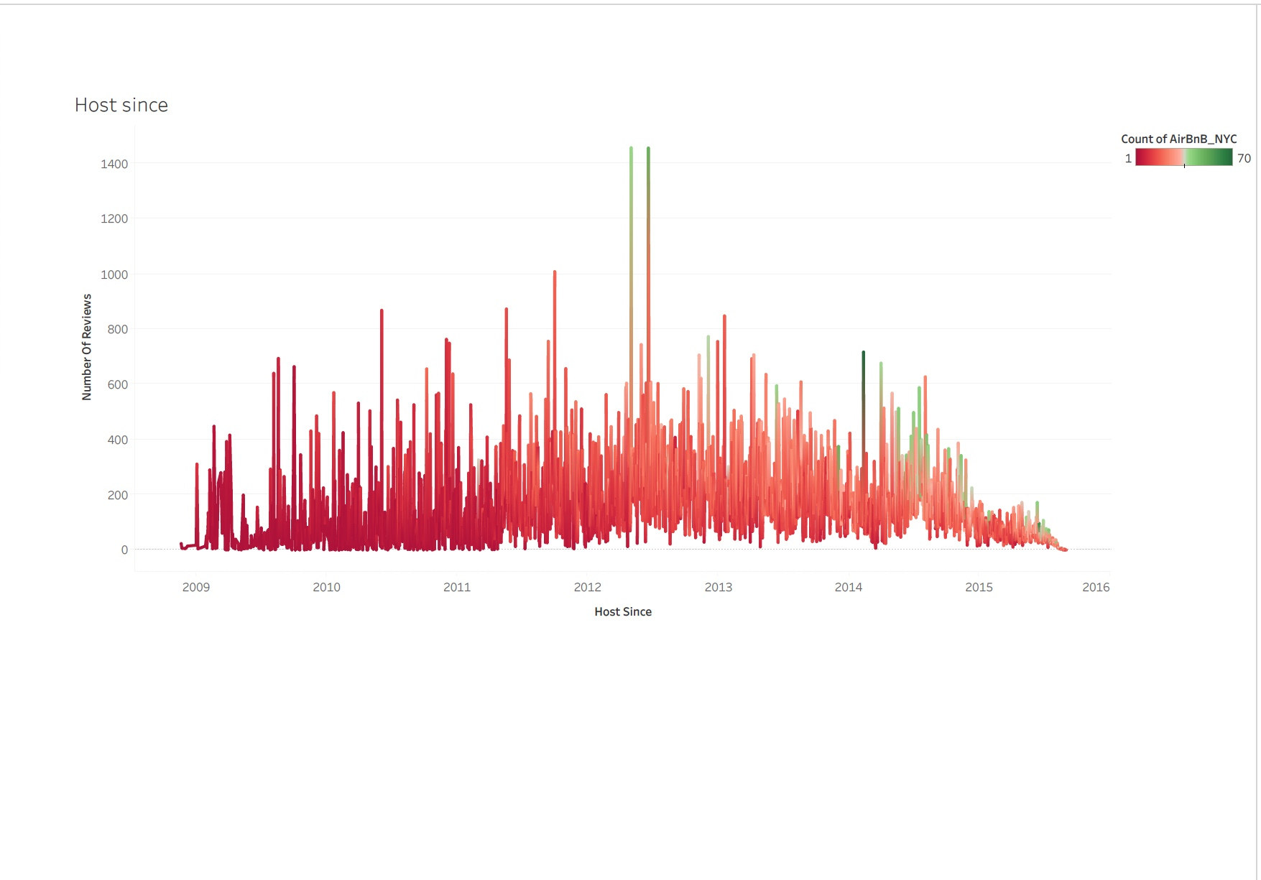
Reviews of hosts and their joining dates

Slide 11
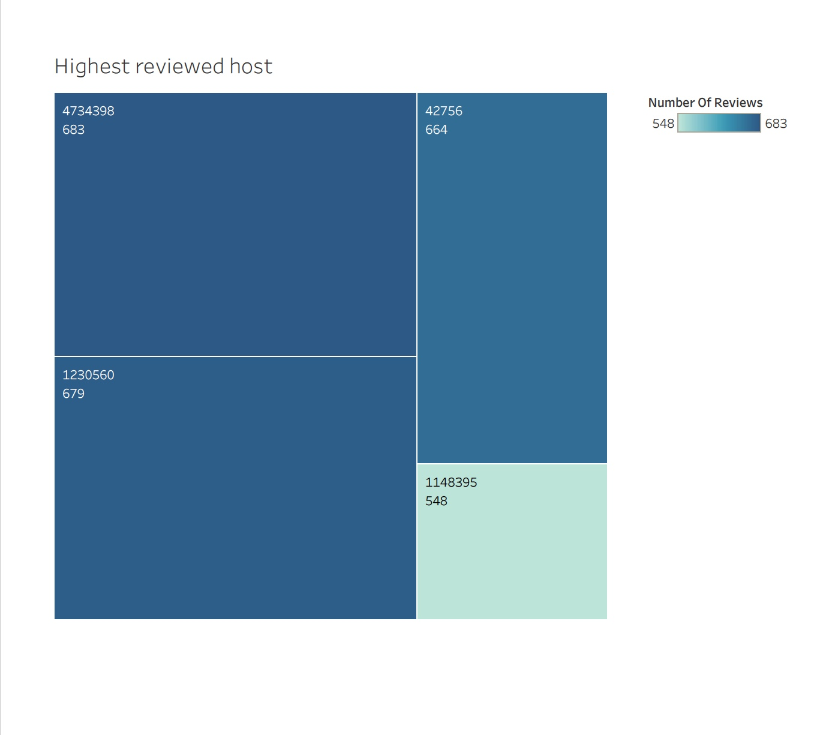
Highest reviewed host

Slide 12
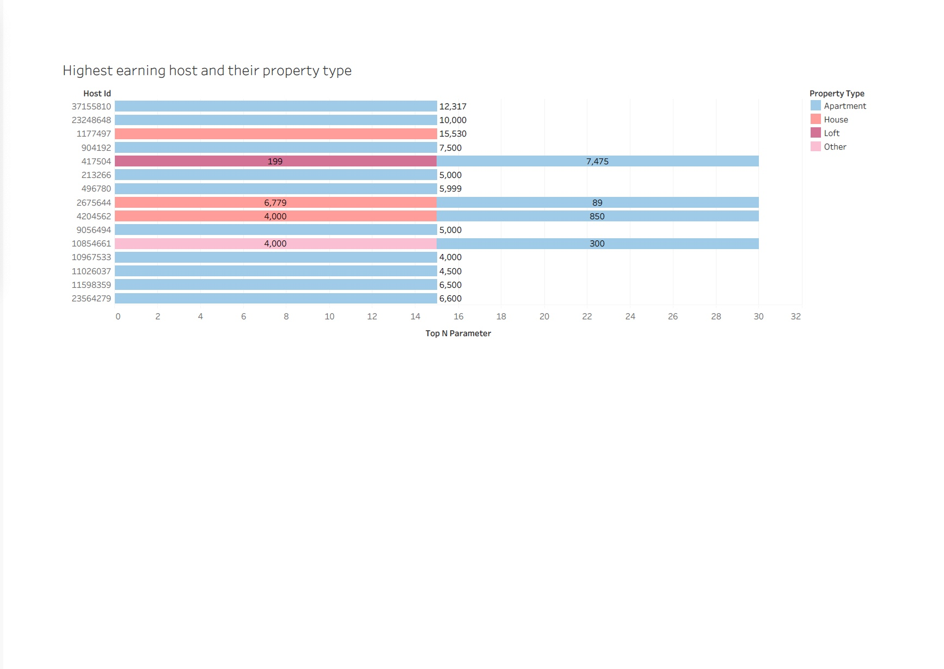
Highest earning host and their property type

Slide 13
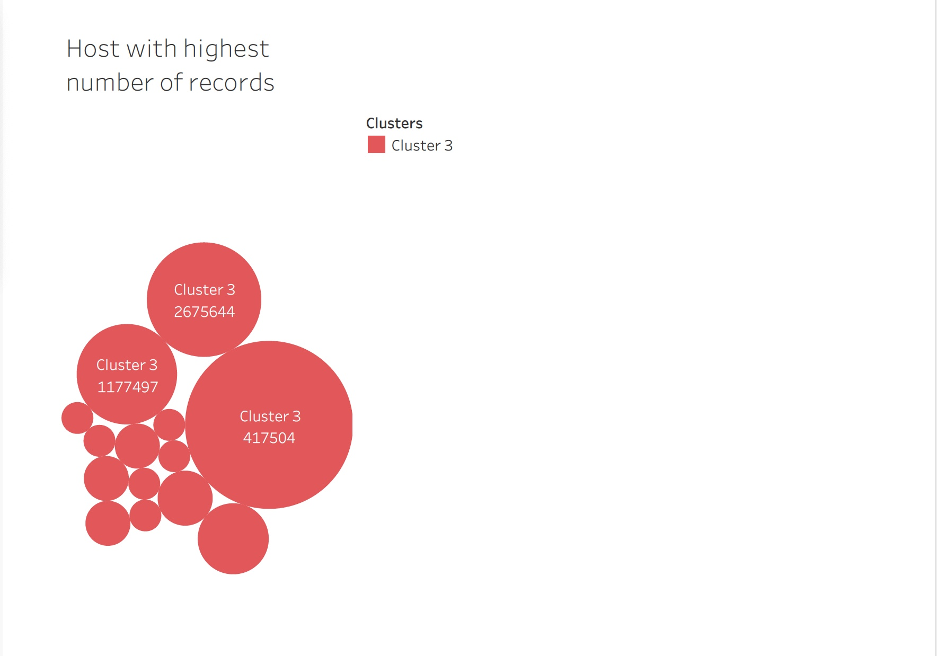
Cluster of hosts with highest number of records.

Slide 14
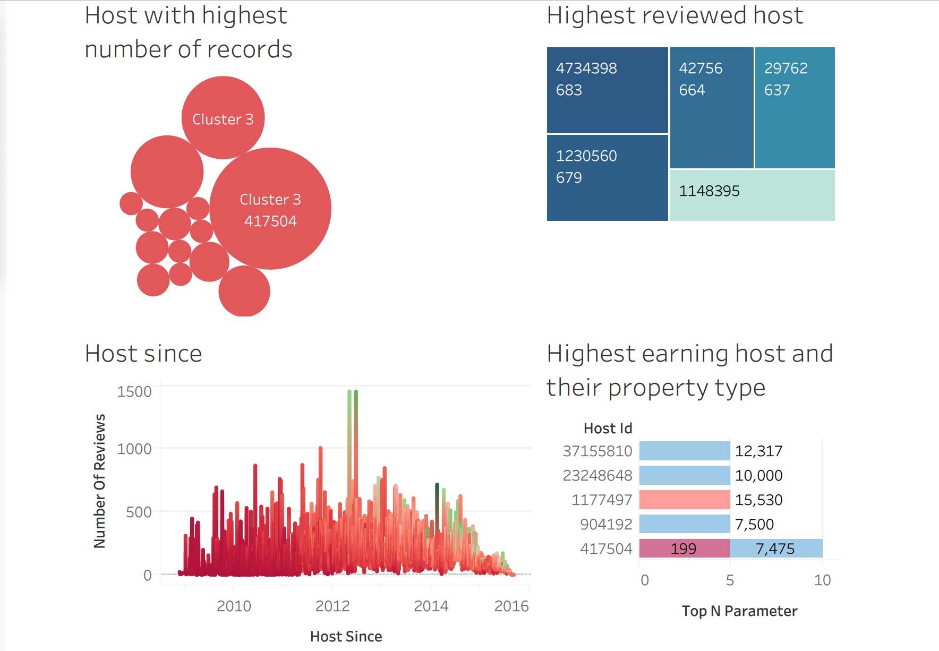
Dashboard describing the host parameters.

